Slide 1
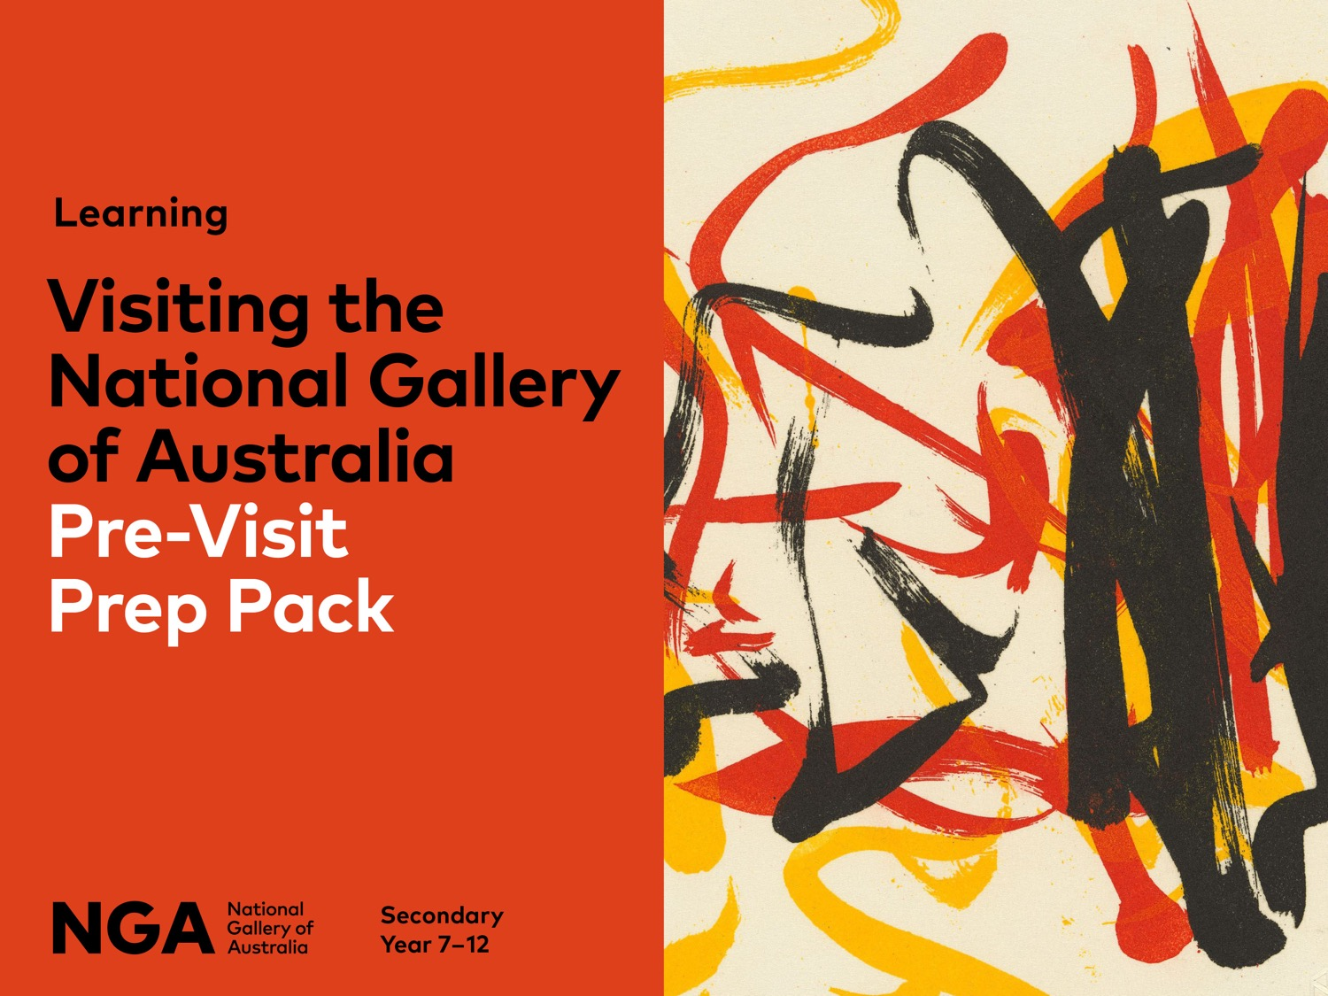
Notes:
Get ready for your visit to the National Gallery of Australia
Use this guide and corresponding PowerPoint presentation to get your students ready for a visit to the National Gallery of Australia. It may be the first time that many of the students have visited an art gallery, and we want them to feel prepared and excited!
After introducing your students to the National Gallery of Australia, we recommend looking into some of the recommended resources for your chosen program. You will find them listed in the program details on our website as well as nearly 100 learning resources.

Slide 2
What is the
National Gallery
of Australia?
Notes:
What is the National Gallery of Australia?
The National Gallery of Australia is home to the nation’s art collection. Located in the nation’s capital, in Canberra, ACT the National Gallery of Australia opened in 1982 and has been welcoming visitors from across Australia and the world ever since. An art gallery is a place that cares for and displays collections of art, at times with a specific focus.

Slide 3
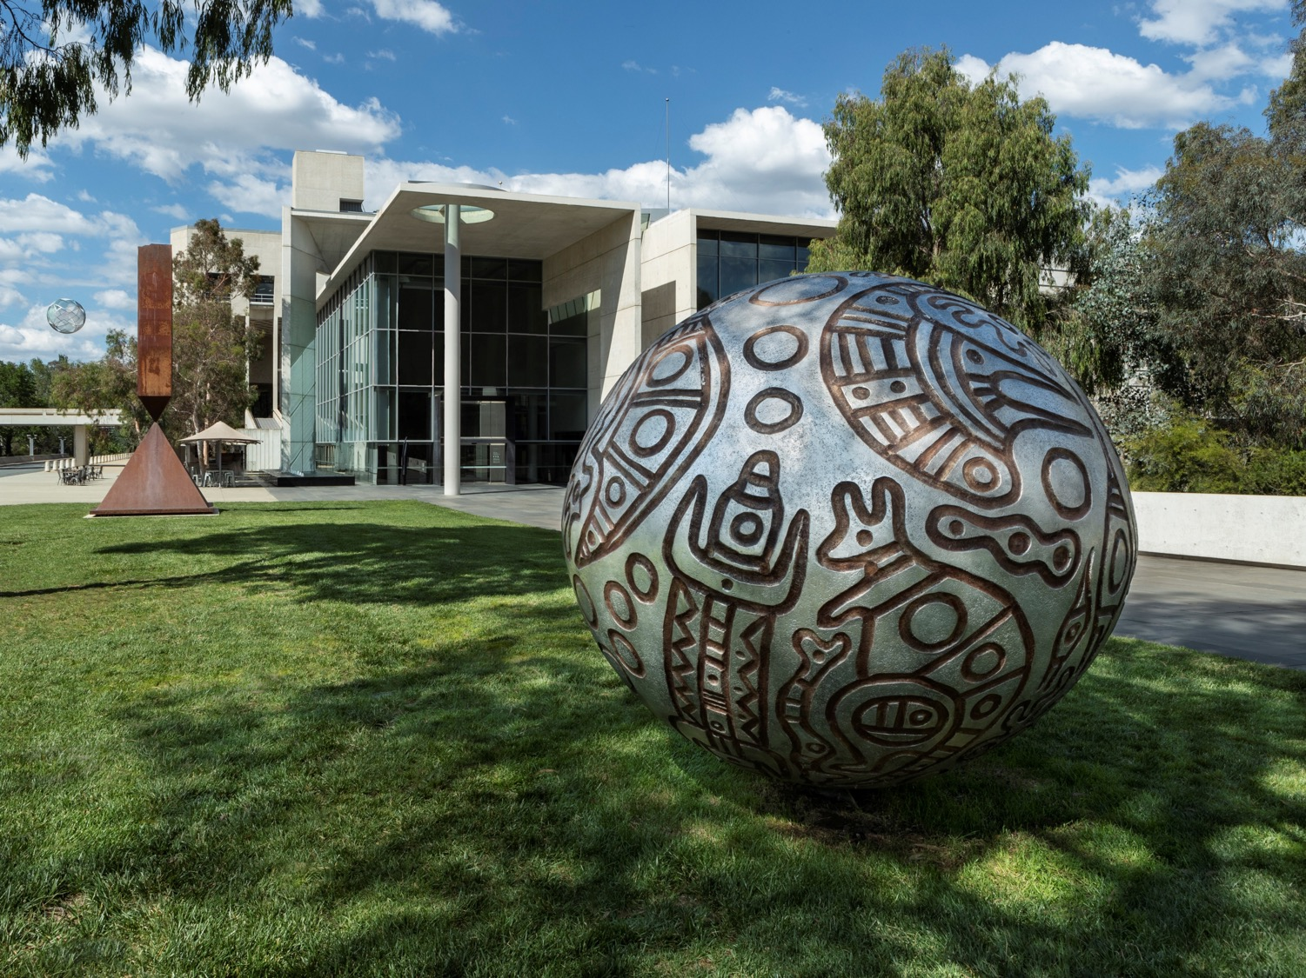
The National Gallery of Australia acknowledges
the Ngunnawal and Ngambri peoples, the traditional custodians of the Canberra region, and recognises
their continuous connection to culture, community
and Country.
Thanakupi Eran 2010, National Gallery of Australia, Canberra, acquired through the Founding Donors' Fund 2010 © the estate of the artist, licensed by Aboriginal Artists Agency Ltd
Notes:
Acknowledgement of Country
The National Gallery of Australia acknowledges the Ngunnawal and Ngambri peoples, the traditional custodians of the Canberra region, and recognises their continuous connection to culture, community and Country.

Slide 4
What will we see
at the National Gallery of Australia?
Notes:
What will we see at the National Gallery of Australia?
Start this conversation by asking students
– What are some of the types of artwork you have seen?
– How do you define art?
Use this definition to help guide the conversation:
The Macquarie Dictionary defines art as ‘the production or expression of what is beautiful (especially visually), appealing, or of more than ordinary significance’. However, some artists push the boundaries, asking us to question ‘Is that art?’.

Slide 5
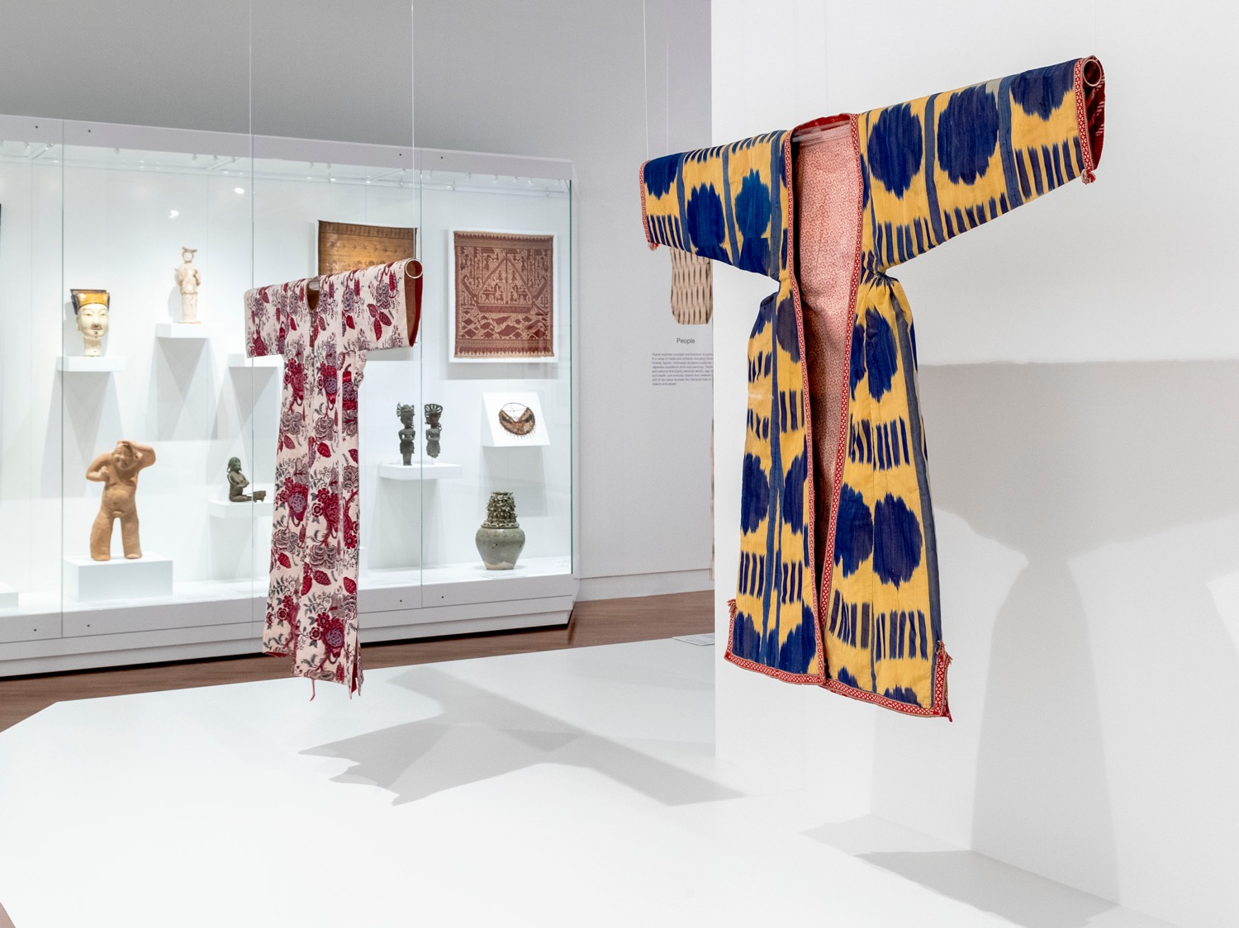
Installation view of Asian art display Devotion, Nature, People and Time 2020.
Notes:
Art and Artists
People who create art are called artists, and they can work in many forms, including painting, sculpture, video and performance. The collection of art held at the National Gallery of Australia also includes design such as costumes and decorative objects.

Slide 6
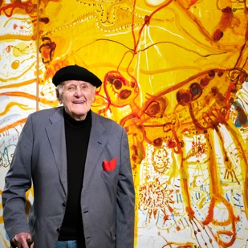
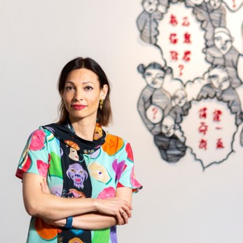

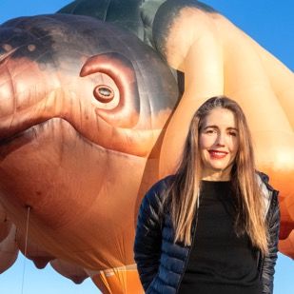
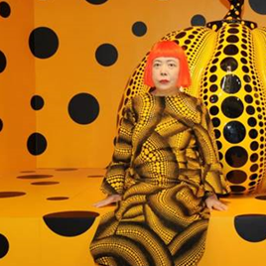
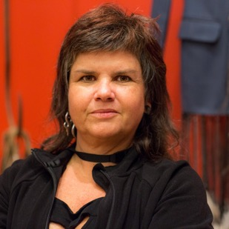
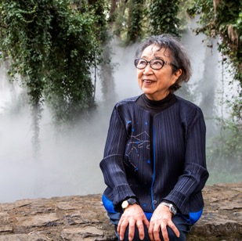
John Olsen
Kate Beynon
Vernon Ah Kee
Patricia Piccinini
Yayoi Kusama
Karla Dickens
Fujiko Nakaya
James Turrell
Notes:
The art in the National Gallery of Australia’s collection is made by artists. For them making art is their job. Many of the artists on display are still living and working today- like the ones featured here. You can click through to learn more about them and the art they make.

Slide 7
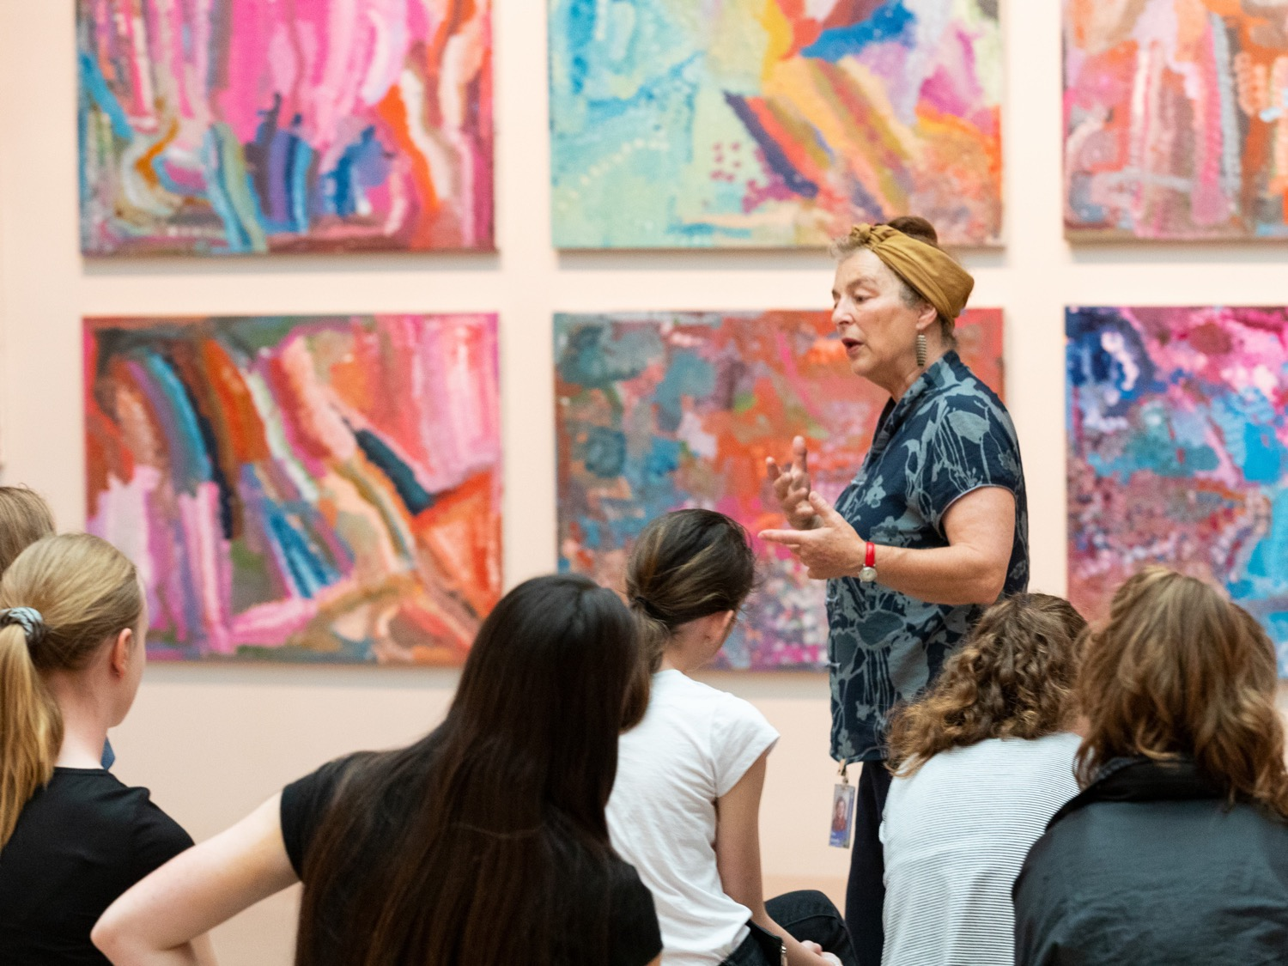
Installation view of an educator with Emily Kame Kngwarreye The Alhalkere Suite, 1993, National Gallery of Australia, Canberra, purchased 1993, © Emily Kame Kngwarreye/Copyright Agency
Notes:
About the Collection
There are more than 160,000 works of art in the collection, however less than 2% are on display at any one time. Many works of art are from Australia, including the largest collection of Aboriginal and Torres Strait Islander art in the world.

Slide 8
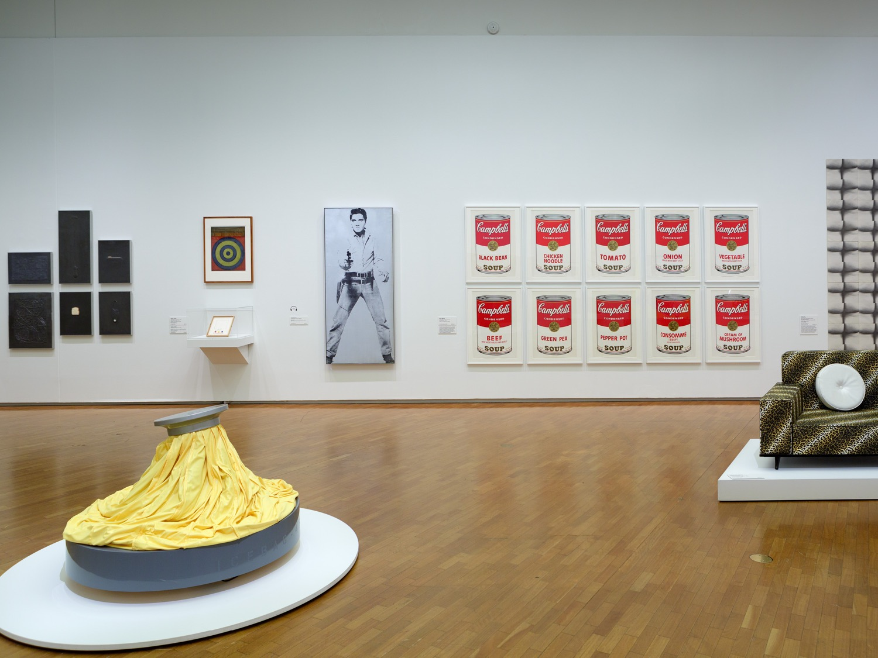
Installation view of International art display 2018.
Notes:
There is also work by artists from across the world, reflecting the diversity of global cultures and the story of art across time.

Slide 9
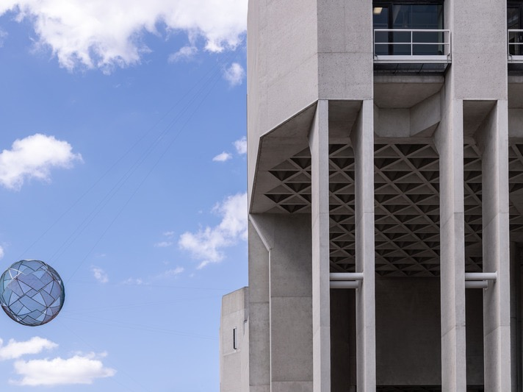
Installation view of Neil Diamonds Diamonds 2002 Commissioned 2002.
Purchased with the assistance of ActewAGL 2002
Notes:
Art Outside
As well as inside the Gallery you will also find art in the surrounding grounds. There are sculptures in the Australian Gardens, the Sculpture Garden and on Parkes Place where your bus will arrive.

Slide 10
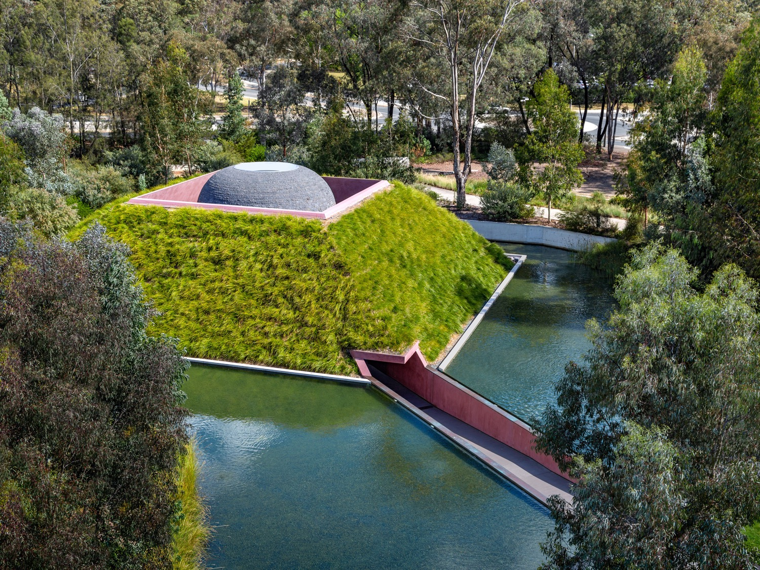
James Turrell Within without 2010 National Gallery of Australia, Canberra. Purchased
with the support of visitors to the exhibition Masterpieces from Paris 2010 © James Turrell
Notes:
If you arrive early and have time before your program you might like to visit Within without a Skyspace by American artist James Turrell. It is in the Australian Gardens and is a work of art that you can walk inside.

Slide 11
What will we do during our visit?
Notes:
What will we do during our visit?
The National Gallery of Australia is a large building with lots happening inside. You will get to see many interesting things during your visit.

Slide 12
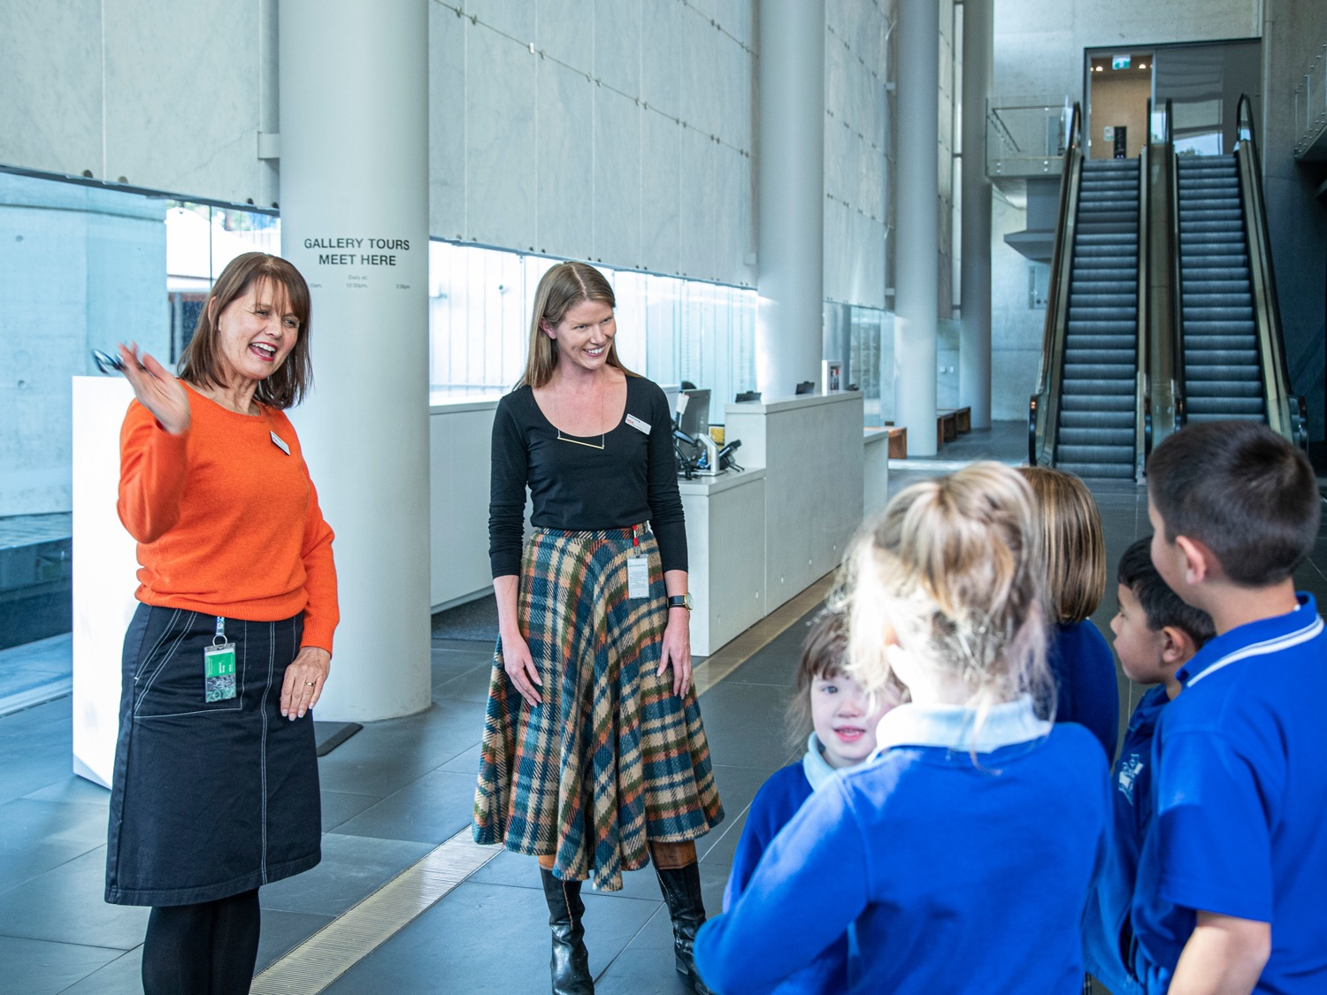
Notes:
When you arrive
When you arrive to the National Gallery of Australia, you will enter through the Main entrance on the lower ground floor. There you will meet the educators or guides who will be showing you around. They will help you put bags away and divide into smaller groups. They will give you a briefing then take you into the galleries.

Slide 13
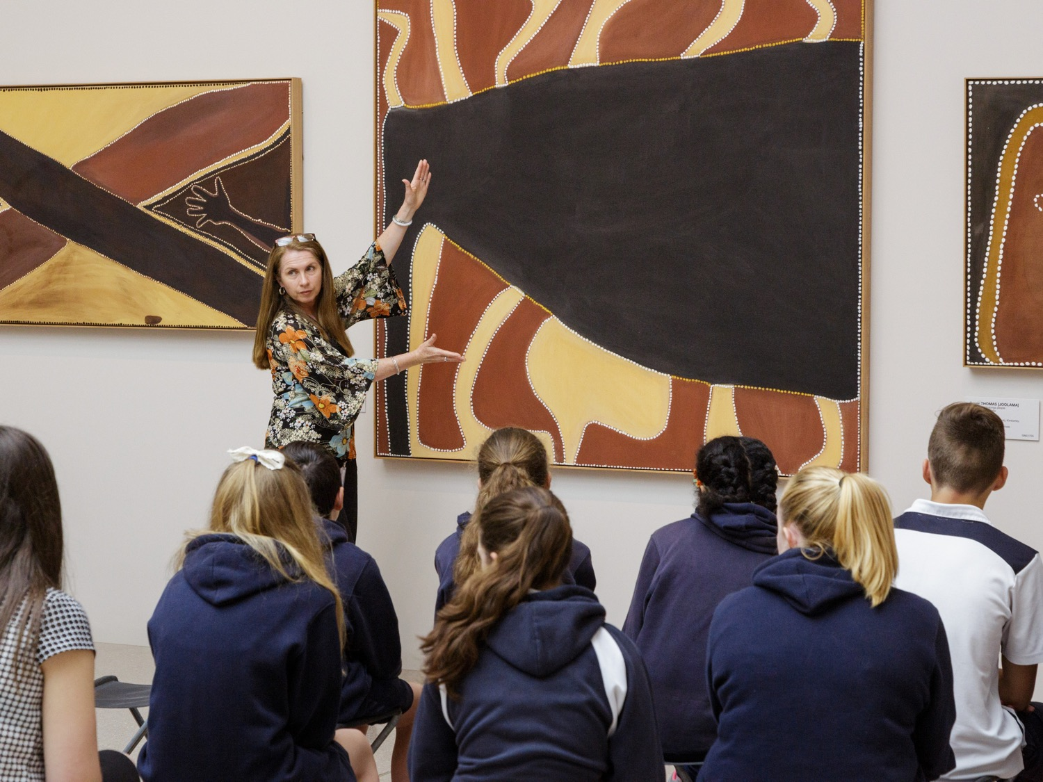
Artist educator with students and Rover Thomas [Joolama] Roads meeting 1987 National Gallery of Australia, Canberra © the artist's estate, courtesy Warmun Art Centre Rover Thomas [Joolama] Cyclone Tracy 1991 National Gallery of Australia, Canberra © the artist's estate, courtesy Warmun Art Centre
Notes:
During the program
The educators and guides will have an interesting program planned which will include sharing works of art from Australia and around the world with your group.

Slide 14
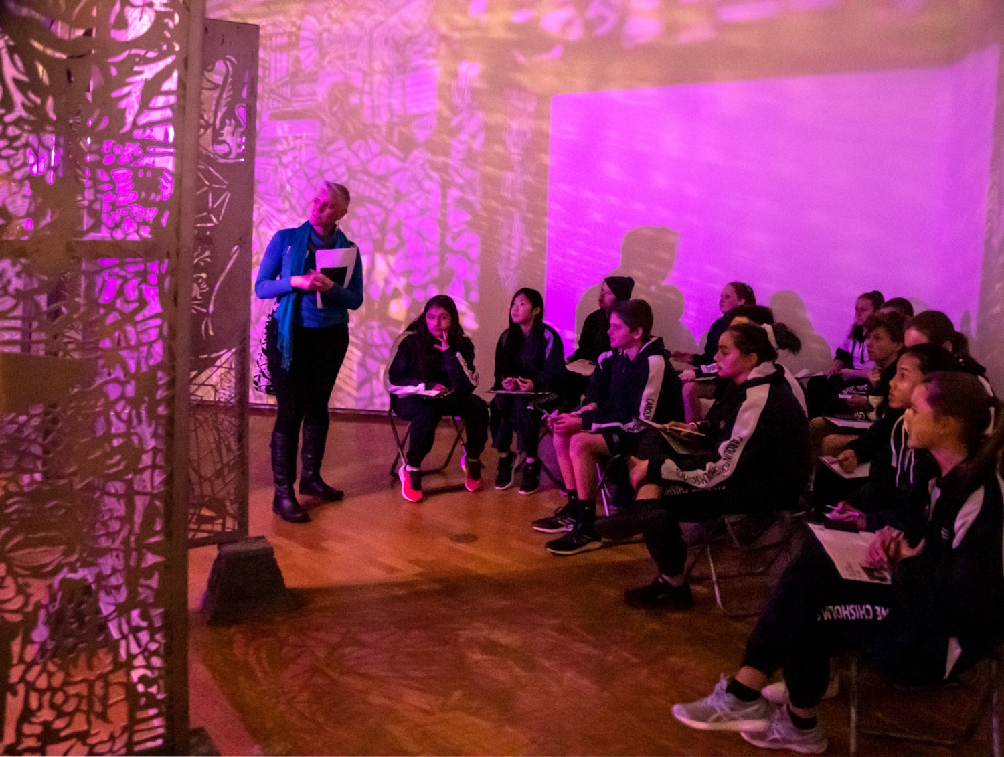
Artist Educator with students and Entang Wiharso Temple of hope: Door to Nirvana 2018-19 National Gallery of Australia, Canberra. Commissioned 2018. Purchased 2019. © Entang Wiharso, Black Goat Studios
Notes:
The educators and guides are excited to hear your ideas about the art you are seeing. It always makes them very happy to hear visitors share their thoughts and ask questions about the art! They will also at times have activities for you to do to respond creatively to the art you are seeing.

Slide 15
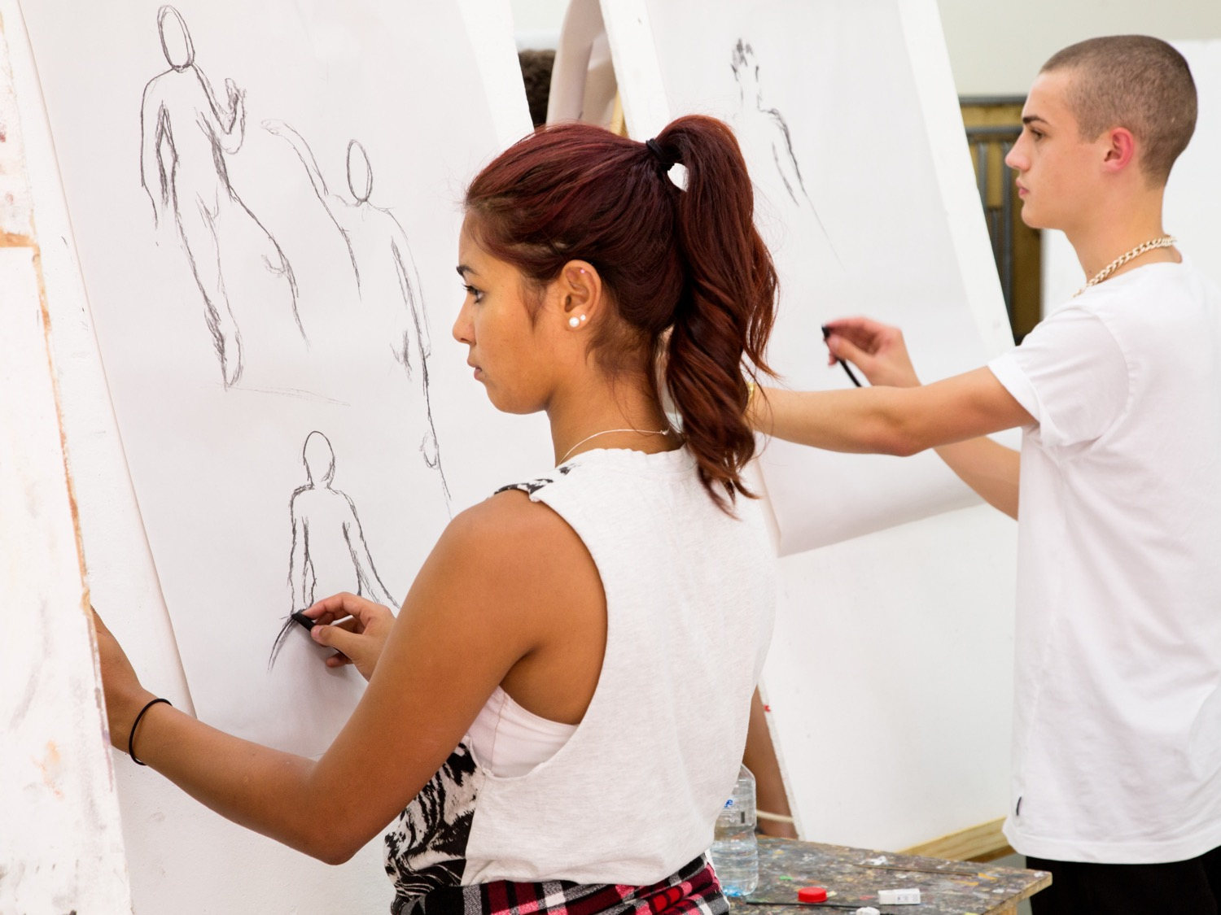
Notes:
If booked for a program in the Tim Fairfax Learning Studio
Depending on which program you are participating in, you may be booked to spend time in the Tim Fairfax Learning Studio.
In the Tim Fairfax Learning Studio, you will get to make your own art inspired by the works of art you have seen in the galleries! Educators are there to help guide you and all students get to take their creations home with them.

Slide 16
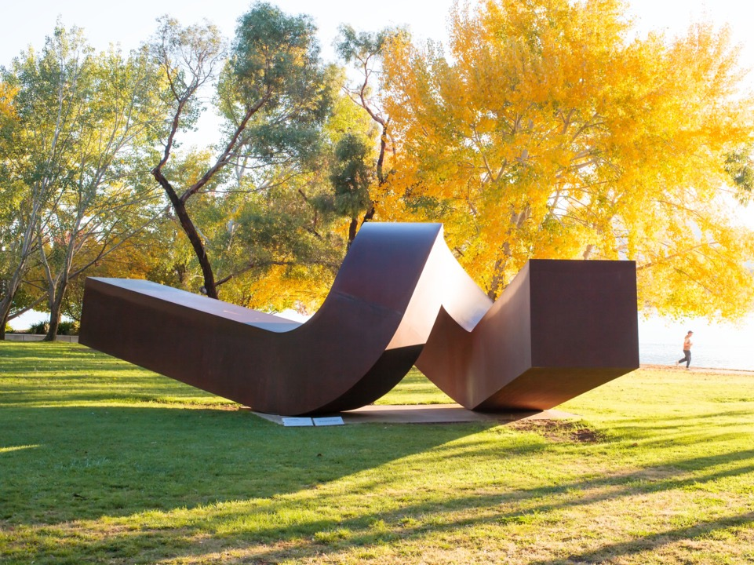
Clement Meadmore Virginia 1970 National Gallery of Australia, Canberra,
purchased 1973 © Meadmore Sculptures, LLC. VAGA/Copyright Agency
Notes:
If you have time, you may like to visit the Sculpture Garden
The Sculpture Garden is free to visit, open all year round and lies between the Gallery and Lake Burley Griffin. It is a lovely place to have lunch and discover sculptures in the natural surrounds. There are toilets and a drinking fountain located there and plenty of benches to sit. Students should always be supervised by their teachers and accompanying adults, as this is a public area.

Slide 17
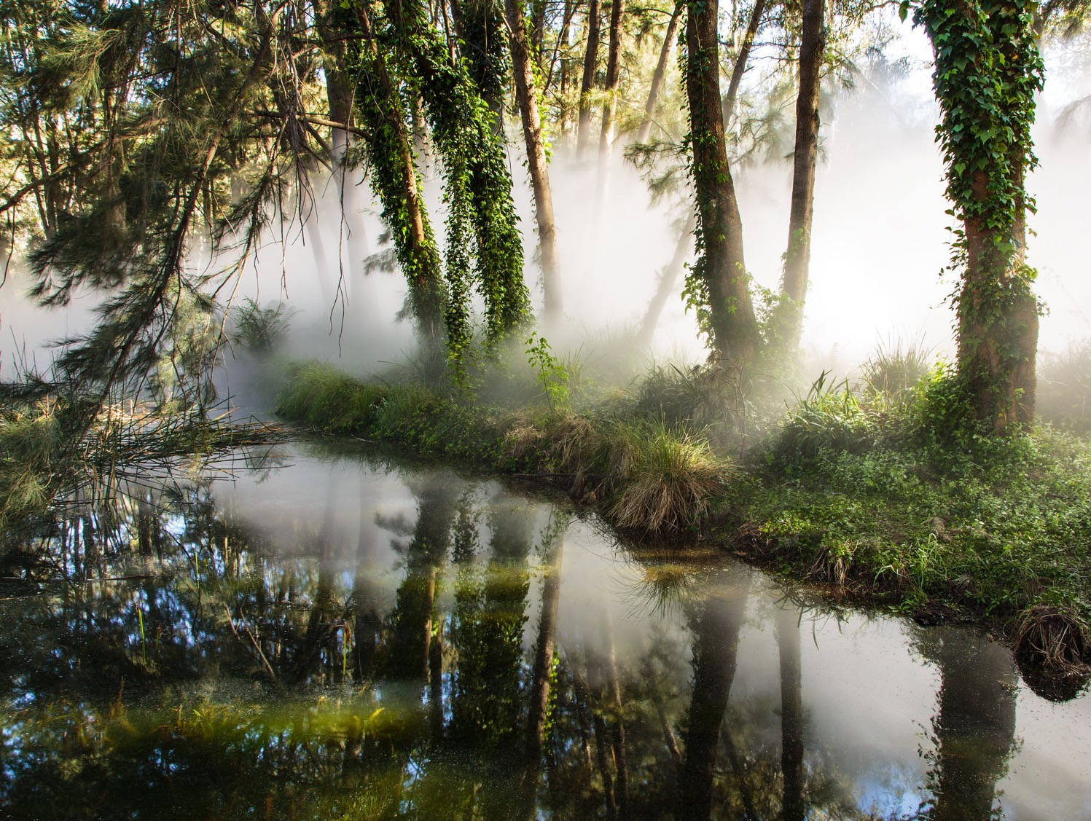
Fujiko Nakaya Foggy wake in a desert: An ecosphere 1982 National Gallery of Australia, Canberra, purchased 1977 © Fujiko Nakaya
Notes:
A highlight of the Sculpture Garden is Fujiko Nakaya’s fog sculpture ‘Foggy wake in a desert: An ecosphere’, which operates between 12.30–2.00pm daily.

Slide 18






Notes:
Art Gallery Etiquette
Discuss art gallery etiquette with your students using the list below.
At the Gallery visitors should:
– Look closely at works of art
– Ask questions
– Respect the works of art by not touching
– Share the Gallery with other visitors
– Use pencils only
– Only take photographs with the flash turned off
– Consume food and drink outside, as they cannot be consumed inside the Gallery

Slide 19
Questions?
learning@nga.gov.au
Notes:
Questions?
Ask your students a few more questions to wrap up and address any queries/ concerns they may have:
– Has anyone been to the National Gallery of Australia before? Or another art gallery? Or museum? If so, what was it like? What do you remember doing?
– What do you hope to see during our visit to the National Gallery of Australia?
– Do you have any other questions?
If you find that you need more specific information please do not hesitate to contact the Gallery on learning@nga.gov.au or call the bookings officer on 02 6240 6519.

Slide 20
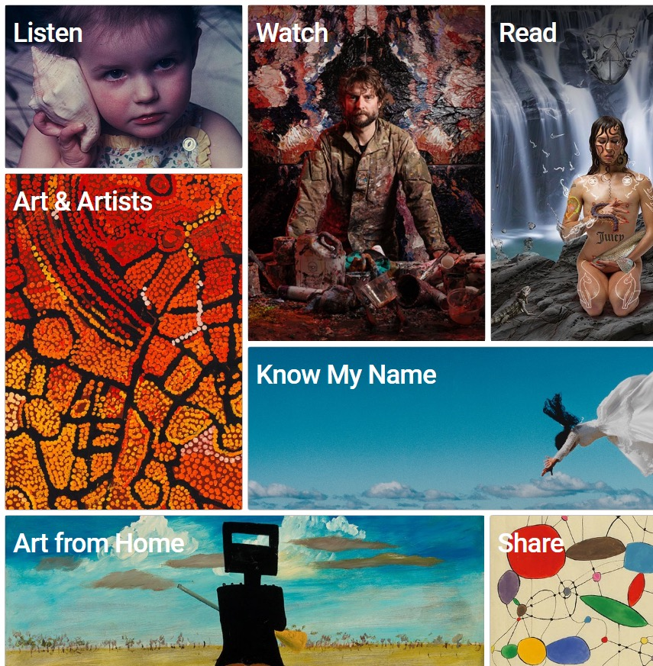
Notes:
Take a look
The Gallery has plenty of content online to help students and teachers to prepare. The website includes current and future exhibitions a collection search, where you can look for an artist or specific work of art and learning resources for students and teachers.

Slide 21
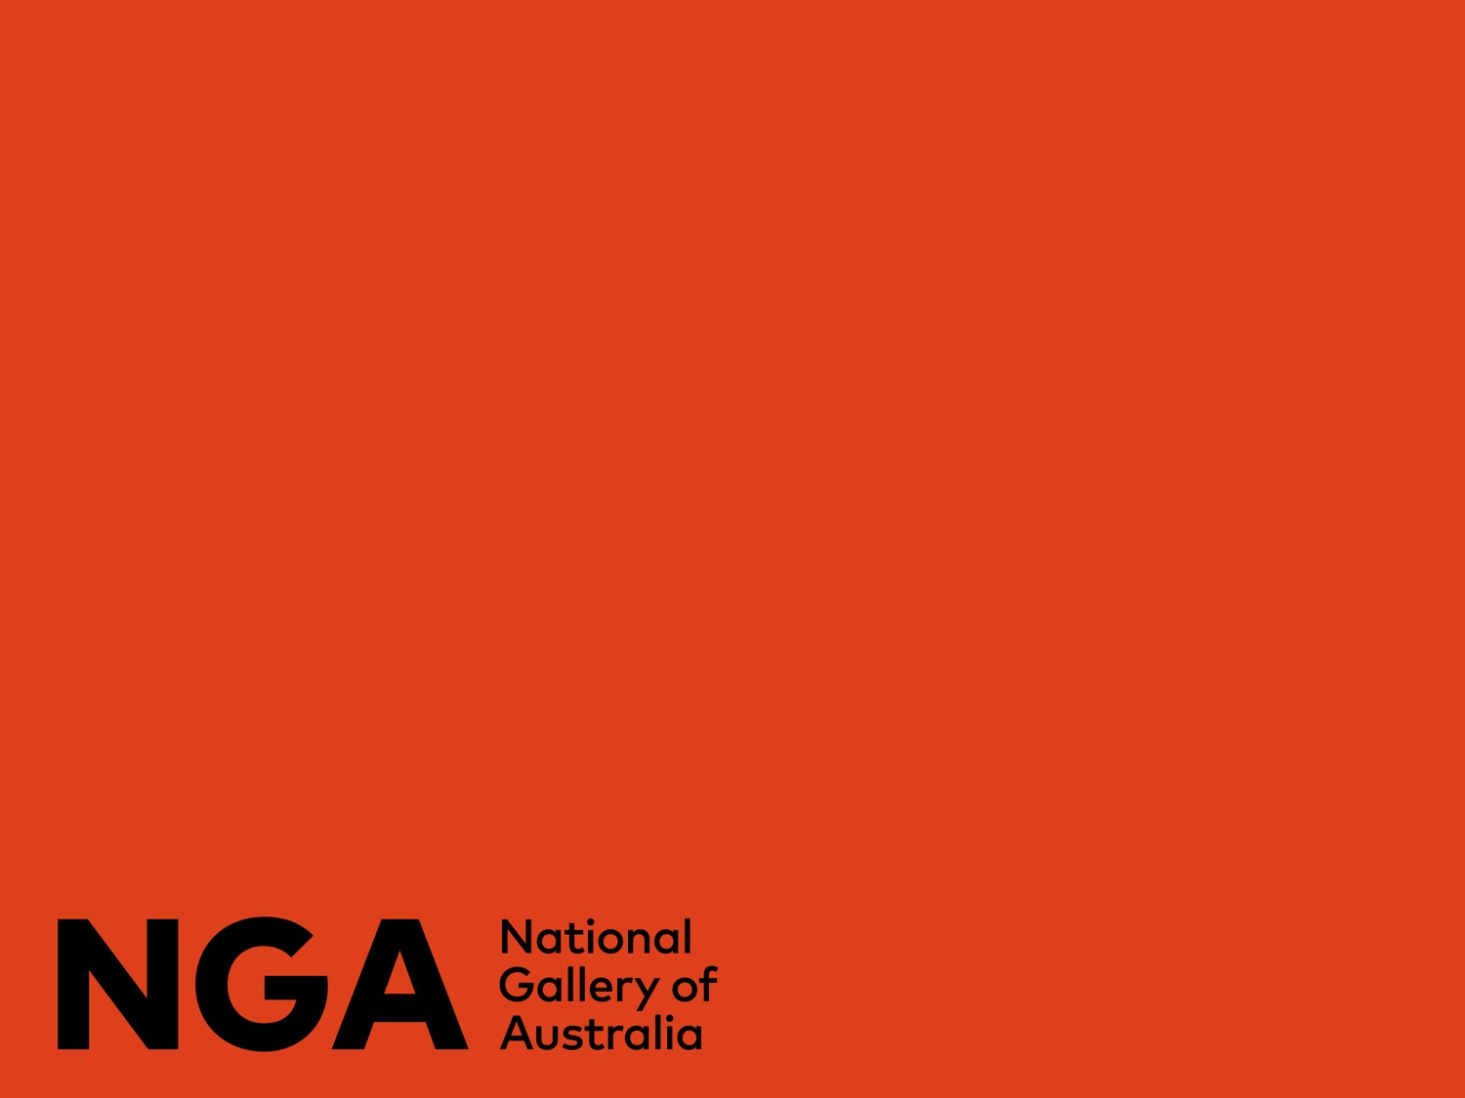
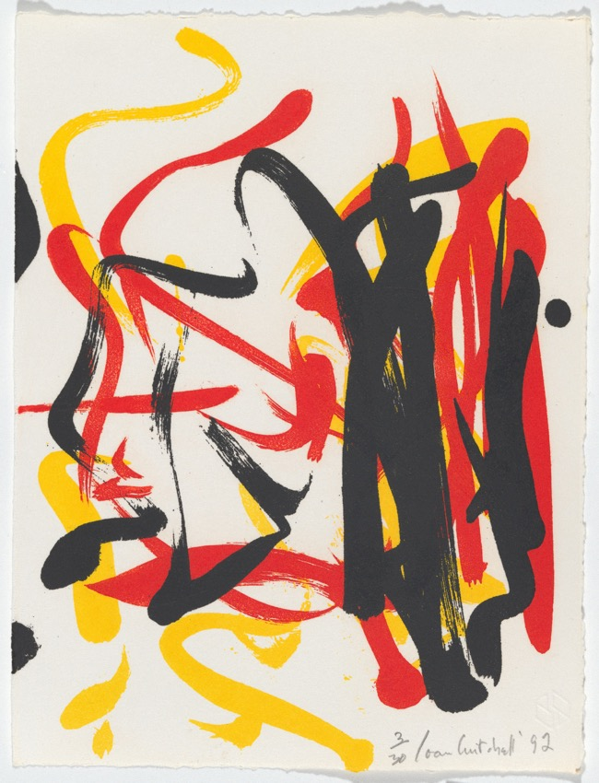
Cover slide: Joan Mitchell Little weeds II (detail) 1992 National Gallery of Australia, Canberra Gift of Kenneth Tyler 2002 © Estate of Joan Mitchell
@NationalGalleryAus
#NationalGalleryAus | #NationalGalleryLearning
Notes:
Follow @NationalGallery.Learning on Instagram for regular updates.
See you soon!

